Slide 1
Interconnect Network Topologies

Slide 2
Characteristics of a network
Topology (what)
  Physical interconnection structure of the network graph.
  Physically limits the performance of the networks.
Routing algorithm (which)
  Restricts the set of paths that messages can follow.
Switching strategy (how)
  How data in a message traverses a route (passing routers)
Flow control mechanism (when)
  When a message or portions of it traverse a route
  What happens when traffic encountered

Slide 3
Topology
How the components are connected.
Important properties
  Diameter: maximum distance between any two nodes in the network (hop count, or # of links).
  Nodal degree: how many links connect to each node.
  Bisection bandwidth: The smallest bandwidth between half of the nodes to another half of the nodes.
A good topology: small diameter, small nodal degree, large bisection bandwidth.

Slide 4
Topology
Regular topologies
  Nodes are connected with some kind of patterns.
    The graph has a structure.
  Nodes are identified by coordinates.
  Routing can usually pre-determined by the coordinates of the nodes.
Irregular topologies
  Nodes are connected arbitrarily.
    The graph does not have a structure, e.g. internet
    More extensible in comparison to regular topology.
  Usually use variations of shortest path routing.

Slide 5
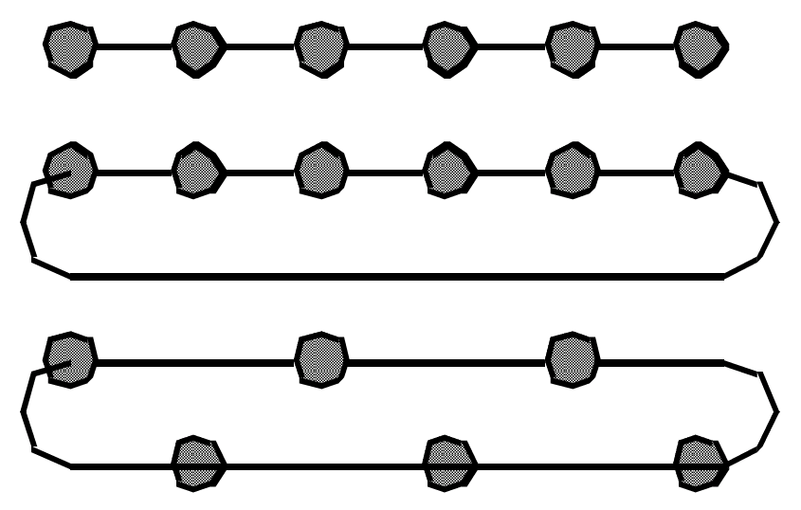
Linear Arrays and Rings
Linear array
Ring (torus)
Short wire torus
Diameter = ?, nodal = ? Bisection bandwidth = ?

Slide 6
Describing linear array and ring
Array: nodes are numbered from 0, 1, …, N-1
  Node i is connected to node i+1, 0<=i<=N-2
Ring: nodes are numbered from 0, 1, …, N-1
  Node i is connected to node (i+1) mod N, for all 0<=i<=N-1

Slide 7
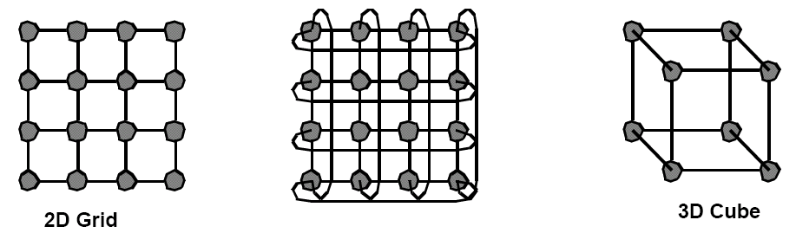
Multidimensional Meshes and Tori
d-dimensional array/torus
  N = k_{d-1} x k_{d-2} x … x k_0
  Each node is described by a d-vector of coordinate
  Node (i_{d-1} x i_{d-2} x …x d_0) is connected to ???

Slide 8
More about multi-dimensional mesh and tori
d-dimension k-ary mesh (torus)
  Each node is described by a d-vector of coordinates.
    The value of each item in the vector is between 0 and d_i-1.
  Diameter = ?
  Nodal degree = ?
  Bisection bandwidth = ?

Slide 9
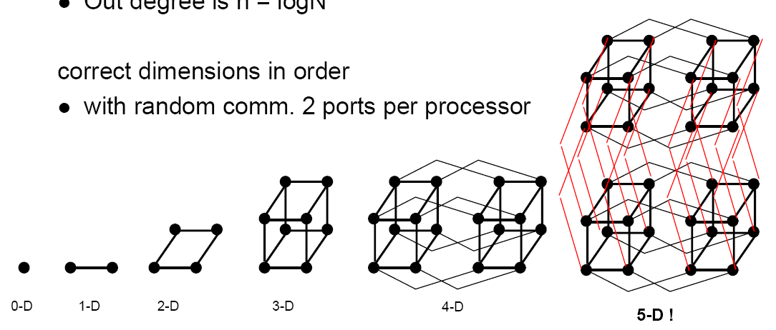
Hypercubes
Also called binary n-cubes. # of nodes = N = 2^n
Each node is described by its binary representation.
  There is a link between two nodes whose binary representations differ by one bit.
Diameter=? Nodal degree = ? Bisection bandwidth = ?

Slide 10
K-ary n-cube (n-dimensional, k-ary mesh/torus)
Extended from binary (hypercube) to k-ary
Each dimension has k elements, n dimensions
Each node is identified by a k-based number (n digits).
  Dimension order routing
4-ary 0-cube
4-ary 1-cube
4-ary 2-cube
4-ary 3-cube

Slide 11
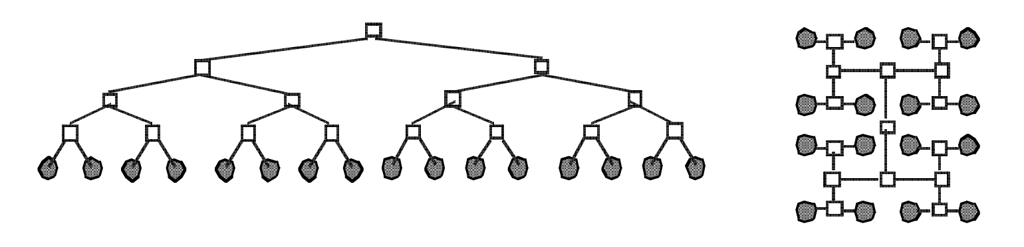
Trees
Fixed degree, log(N) diameter, O(1) bisection bandwidth.
Routing: up to the common ancestor than go down.

Slide 12
Irregular topology
Irregular topology does not any special mathmetic properties
  Can be expanded in any way.
  No easy way for routing: routes need to be computed like in the Internet.
    Routes can usually be determined in a regular network by using the coordinates of the source and destination.

Slide 13
Direct and indirect networks
All the previously discussed networks are direct networks in that the compute nodes are directly attached to the nodes in the topology.
  An example mesh system.
Each switch is a 5x5 switch

Slide 14
Indirect networks
Compute nodes are not directly attached to each switch, but are rather attached to the whole network.
  Using a central interconnect to connect all compute nodes
  The network emulate the cross-bar switch functionality.

Slide 15
Fully connected network
Different organizations:
  Connected by one switch (crossbar switch), connecting all nodes, connected with a crossbar.
All permutation communication (each node sends one message and receives one message) can be realized.

Slide 16
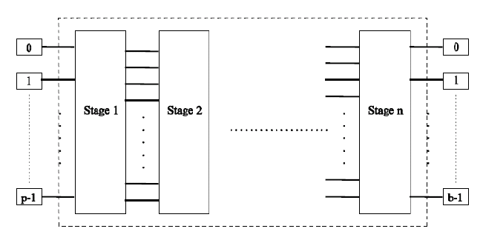
Multistage interconnection networks (MIN)
Try to emulate the cross-bar connection.
  Realizing permutation without blocking
  Using smaller cross-bar(2x2, 4x4) switches as the building block. Usually O(Nlg(N)) switches (lg(N) stages.

Slide 17
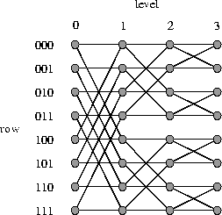
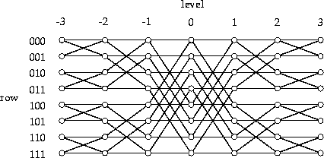
Multi-stage networks examples
(a) An 8-input butterfly network
(b) An 8-input Benes network
MINs can be blocking or non-blocking
  Blocking: there exist some permutation that results in link contention.
  Non-blocking: any permutation can be realized without link contention
Butterfly network is blocking.
Benes network is non-blocking.

Slide 18
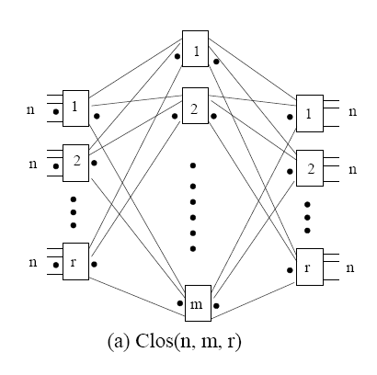
Clos Network
Three stages: ingress stage, middle stage, and egress stage
  Ingress/egress stage has r n X m switches
  Middle stage has m r X r switches
  Each switch at ingress/egress stage connects to all m middle switches (one port to each switch).

Slide 19
Clos Network
Clos network is non-blocking when m>=2n-1.

Slide 20
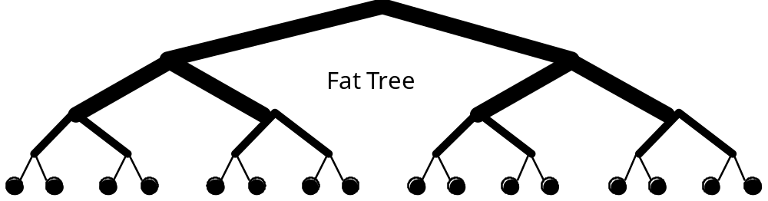
Fat-Trees
Fatter links (really more of them) as you go up, so bisection BW scales with N
  Not practical, root is an NxN switch

Slide 21
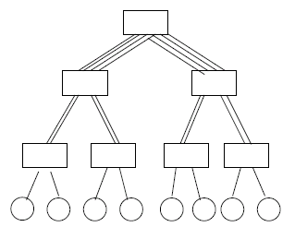
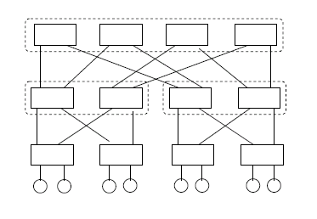
Practical Fat-trees
Use smaller switches to approximate large switches.
  Connectivity is reduced, but the topology is not implementable
  Most commodity large clusters use this topology. Also call constant bisection bandwidth network (CBB)

Slide 22
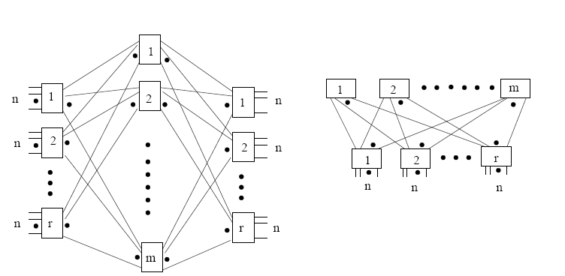
Clos network and fat-tree (folded Clos)
A generic 2-level fat-tree (folded Clos)
A generic 3-stage Clos network

Slide 23
Physical constraint on topologies
Number of dimensions.
  2 or 3 dimensions
    Can layout physically
    Short wires, easy to build
    Many hops, low bisection bandwidth
  >=4 dimensions
    Harder to build, longer wires
    Fewer hops, better bisection bandwidth
  K-ary n-cubes provide a good framework for comparison.

